Slide 1
Java Basics
Abstract Classes, Interfaces, Inheritance and Polymorphism

Slide 2
Disclaimer
Document Name:
Data Classification: INTERNAL
Disclaimer
The contents of this document are property of Softtek, and are classified as Confidential. Any reproduction in whole or in part is strictly prohibited without the written permission of Softtek.
This document is subject to change. Comments, corrections or questions should be directed to the author.
Audience/Viewership | Purpose
Java Beginners | Training
Revision Chart
The following chart list the revisions made to this document. Use this to describe the changes and additions each time this document is re-published. The description should be detailed as possible and include the names of the reviewers who request the changes.
Version No. | Version Date | Types of Changes | Owner/Author | Date of Review/Expiration
1 | 2015/07/23 | Creation | Luis Robles | NA

Slide 3
Lesson 4: Abstract Classes, Interfaces, Inheritance and Polymorphism

Slide 4
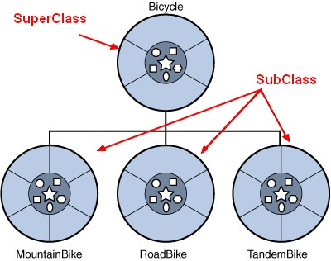
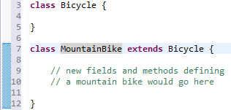
Inheritance
Object-oriented programming allows classes to inherit commonly used state and behavior from other classes
The syntax for creating a subclass is simple

Slide 5
Inheritance (cont.)
A class that is derived from another class is called a subclass (also a derived class, extended class, or child class)
The class from which the subclass is derived is called a superclass (also a base class or a parent class).
Excepting Object, which has no superclass, every class has one and only one direct superclass (single inheritance).
In the absence of any other explicit superclass, every class is implicitly a subclass of Object.
A subclass inherits some the members (fields, methods, and nested classes) from its superclass... According to modifier access (public / protected / private)
Constructors are not members, so they are not inherited by subclasses, but the constructor of the superclass can be invoked from the subclass.
Generalization reduces complexity by replacing multiple entities which perform similar functions with a single construct

Slide 6
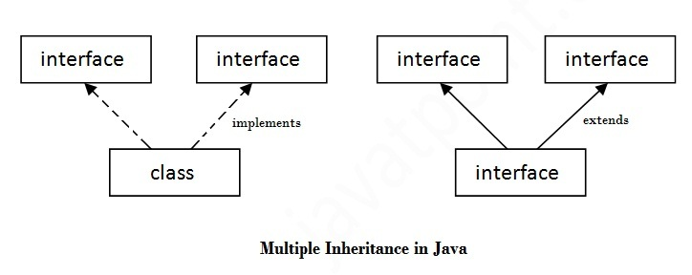
Multiple Inheritance
Multiple Inheritance of State, it is the ability to inherit fields from multiple classes. Don't supported by Java
Multiple inheritance of implementation. A class can implement more than one interface. A new feature from Java 8 (default methods inside to Interface).
Multiple inheritance of type: it is the ability of a class to implement more than one interface
An Interface can extend from multiple Interfaces.
Notes:
One reason why the Java programming language does not permit you to extend more than one class is to avoid the issues of multiple inheritance of state, which is the ability to inherit fields from multiple classes. For example, suppose that you are able to define a new class that extends multiple classes. When you create an object by instantiating that class, that object will inherit fields from all of the class's superclasses. What if methods or constructors from different superclasses instantiate the same field? Which method or constructor will take precedence? Because interfaces do not contain fields, you do not have to worry about problems that result from multiple inheritance of state.
Multiple inheritance of implementation is the ability to inherit method definitions from multiple classes. Problems arise with this type of multiple inheritance, such as name conflicts and ambiguity. When compilers of programming languages that support this type of multiple inheritance encounter superclasses that contain methods with the same name, they sometimes cannot determine which member or method to access or invoke. In addition, a programmer can unwittingly introduce a name conflict by adding a new method to a superclass. Default methods introduce one form of multiple inheritance of implementation. A class can implement more than one interface, which can contain default methods that have the same name. The Java compiler provides some rules to determine which default method a particular class uses.
The Java programming language supports multiple inheritance of type, which is the ability of a class to implement more than one interface. An object can have multiple types: the type of its own class and the types of all the interfaces that the class implements. This means that if a variable is declared to be the type of an interface, then its value can reference any object that is instantiated from any class that implements the interface.
As with multiple inheritance of implementation, a class can inherit different implementations of a method defined (as default or static) in the interfaces that it extends. In this case, the compiler or the user must decide which one to use.

Slide 7

Abstract Classes
Abstract classes, which declared with the abstract keyword (it may or may not include abstract methods)
Abstract classes cannot be instantiated, but they can be subclassed
It can only be used as a super-class for other classes that extend the abstract class
A class can inherit only from one abstract class
If a class includes abstract methods, then the class itself must be declared abstract
The purpose of abstract classes is to function as base classes which can be extended by subclasses to create a full implementation
Abstract classes are ideal when implementing frameworks.

Slide 8
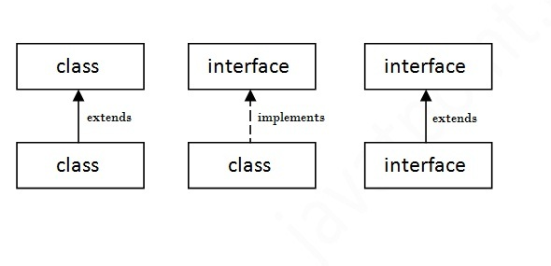
Interfaces
An interface in java is a blueprint of a class. It has static constants and abstract methods only.
An Interface is a Pure Abstract Class, all methods don’t have implementation... abstract methods.
Abstract Classes vs Interfaces
Relationship between classes and Interfaces
Notes:
Abstract Classes Compared to Interfaces
Abstract classes are similar to interfaces. You cannot instantiate them, and they may contain a mix of methods declared with or without an implementation. However, with abstract classes, you can declare fields that are not static and final, and define public, protected, and private concrete methods. With interfaces, all fields are automatically public, static, and final, and all methods that you declare or define (as default methods) are public. In addition, you can extend only one class, whether or not it is abstract, whereas you can implement any number of interfaces.
Which should you use, abstract classes or interfaces?
- Consider using abstract classes if any of these statements apply to your situation:
+ You want to share code among several closely related classes.
+ You expect that classes that extend your abstract class have many common methods or fields, or require access modifiers other than public (such as protected and private).
+ You want to declare non-static or non-final fields. This enables you to define methods that can access and modify the state of the object to which they belong.
- Consider using interfaces if any of these statements apply to your situation:
+ You expect that unrelated classes would implement your interface. For example, the interfaces Comparable and Clonable are implemented by many unrelated classes.
+ You want to specify the behavior of a particular data type, but not concerned about who implements its behavior.
+ You want to take advantage of multiple inheritance of type.
An example of an abstract class in the JDK is AbstractMap, which is part of the Collections Framework. Its subclasses (which include HashMap, TreeMap, and ConcurrentHashMap) share many methods (including get, put, isEmpty, containsKey, and containsValue) that AbstractMap defines.
An example of a class in the JDK that implements several interfaces is HashMap, which implements the interfaces Serializable, Cloneable, and Map<K, V>. By reading this list of interfaces, you can infer that an instance of HashMap (regardless of the developer or company who implemented the class) can be cloned, is serializable (which means that it can be converted into a byte stream), and has the functionality of a map. In addition, the Map<K, V> interface has been enhanced with many default methods such as merge and forEach that older classes that have implemented this interface do not have to define.
Note that many software libraries use both abstract classes and interfaces; the HashMap class implements several interfaces and also extends the abstract class AbstractMap.

Slide 9

Polymorphism
Polymorphism is the ability of an object to take on many forms → behavior
In java language, polymorphism is essentially considered into two versions:
Compile time polymorphism (static binding or method overloading)
Runtime polymorphism (dynamic binding or method overriding)

Slide 10
Overloading
The conditions for method overloading
1.) The number of parameters is different for the methods.
2.) The parameter types are different (like changing a parameter that was a float to an int).
Overloading is a compile time phenomenon
How to NOT overload methods:
1. Just changing the return type of the method. If the return type of the method is the only thing changed, then this will result in a compiler error.
2. Changing just the name of the method parameters, but not changing the parameter types. If the name of the method parameter is the only thing changed then this will also result in a compiler error.

Slide 11
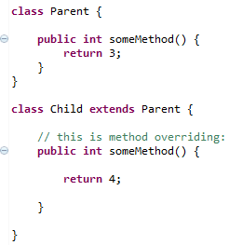
Overriding
If a derived class requires a different definition for an inherited method, then that method can be redefined in the derived class
An overridden method would have the exact same method name, return type, number of parameters, and types of parameters as the method in the parent class, and the only difference would be the definition of the method
Overriding is a run time phenomenon
Overriding means that a method inherited from a parent class will be changed
Notes:
An overridden method would have the exact same method name, return type, number of parameters, and types of parameters as the method in the parent class, and the only difference would be the definition of the method

Slide 12
Links and References
https://docs.oracle.com/javase/tutorial/index.html
http://docs.oracle.com/javase/tutorial/java/concepts/interface.html
http://docs.oracle.com/javase/tutorial/java/concepts/inheritance.html
http://www.oracle.com/technetwork/java/codeconvtoc-136057.html

Slide 14
Luis Robles
luisf.robles@softtek.com
Related to training material (Java Basics module)
Sarahi Flores
sarahi.flores@softtek.com
Instructor

